Slide 1
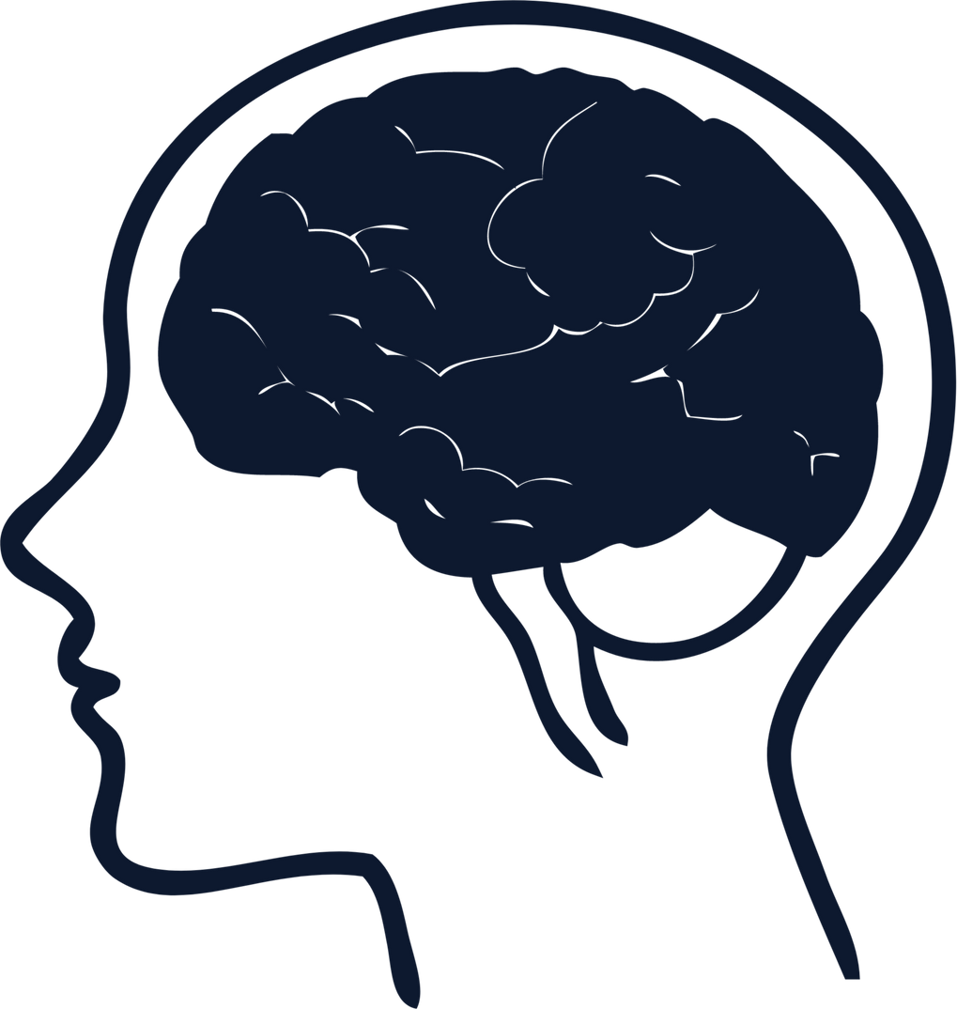

SQUARES
CIARAN O’ TOOLE
C00297672
03/02/2026
YEAR 3 PROJECT
Structured support for cognitive health.

Slide 2


WHAT IS SQUARES
Squares is a mobile application which provides elderly individuals cognitive enhancement structured around everyday tasks.
The software, which supports independent living and cognitive function, employs a virtual coach to encourage commitment through personalized productivity comments and incentives.
Squares emphasizes useful cognitive abilities related to daily activities and is offered to elderly individuals through an intuitive, age-appropriate user interface.

Slide 3



APP STRUCTURE: LOGIC
React Native is a Framework used commonly for mobile application development using JavaScript and React (JavaScript Library). Using this, a simple elderly friendly UI can be created.
Using PuzzleMe I will develop my own applications and include PuzzleMe features through the PuzzleMe APIs.
Amazon Web Services will be used for hosting User data, track scores, etc. This allows for updating & tracking of user data through our app.

Slide 4
APP STRUCTURE: PUZZLES
PUZZLES WITH INCREASING DIFFICULTY
Squares is a cognitive puzzle application that modifies its current state of difficulty according to user progression monitored by an AWS database.
Puzzles automatically adjusts difficulty according to performance.
A virtual assistant provides users with guidance, feedback, and regular notifications to encourage consistent involvement and dedication over time.
ASSISTED GUIDANCE
PROGRESS & ANALYTICS
DAILY REMINDERS

Slide 5
The mental processes that allow individuals to acquire knowledge, process information, think, and solve issues are commonly referred to as cognitive function.
Regular exercise, adequate sleep, a nutritious diet, mental exercises mindfulness and meditation are all strategies to improve your brain's cognitive skills. We at Squares focus directly on the Mental Exercises aspect.
SO WHAT IS COGNITIVE FUNCTION
Reasoning
Memory
Attention
Perception
Language
Learning

Slide 6
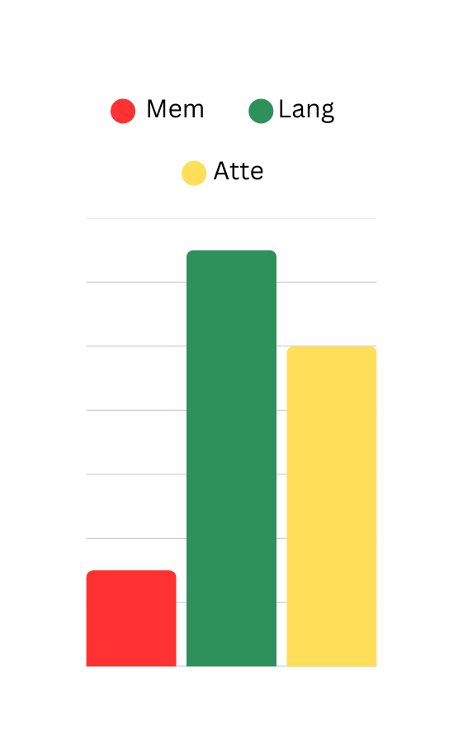
HOW WE TRACK DATA & ASSIST GROWTH
Assess, Analyze, Adjust, Assist
Assess performance, speed, correctness, etc.
Analyze data and track falls/peaks in progression.
Adjust puzzle difficulty accordingly & shift focus to weaker pillars.
Assist users with feedback.

Slide 7
FIRST ITERATION PLAN
Construct and link up a simple set of puzzles using the PuzzleMe site & API.
Record simple data, like completion times or average time spent on certain sections.
Test out adaptive difficulty, value tracking.
Simplistic UI, basic functionality, don’t focus too heavy on looks.
Set up database for storing simple test data.

Slide 8
SQUARES
Structured support for cognitive health.

